Slide 1
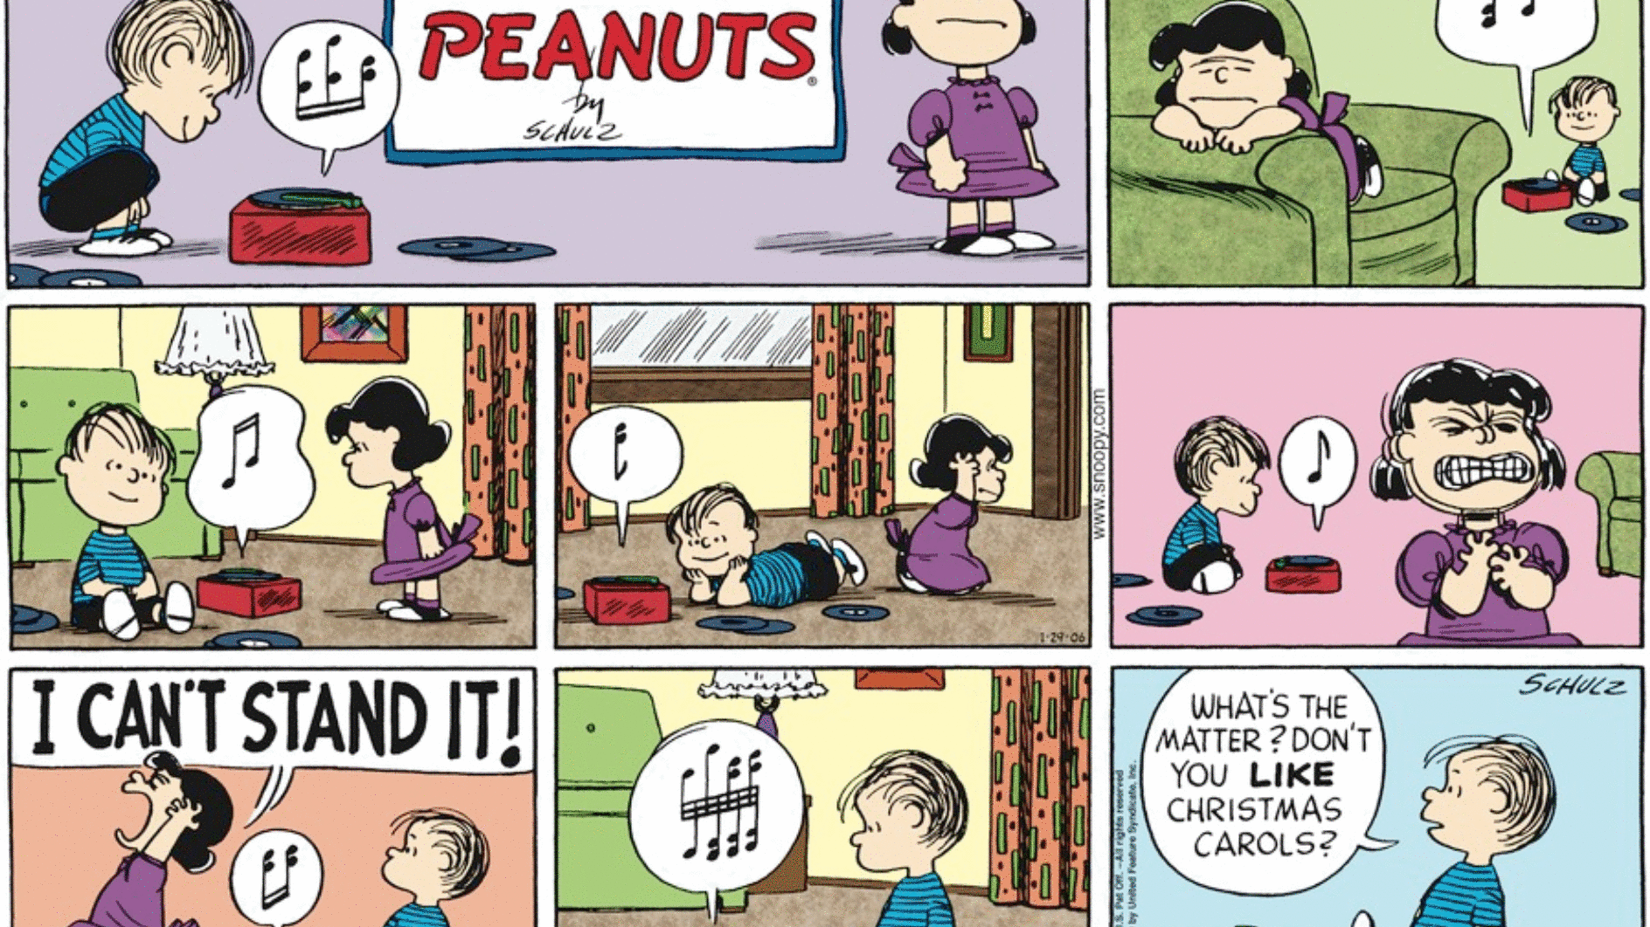
Comic Strip
Must include a title and created by panel
Must be a minimum of six panels
Must include all important events of this scene

Slide 2
Impassioned letter to the Police
Must include an emotional RANT to why the police need to be involved.
Must be one full page in length. Creating multiple paragraphs.
Remember letter is to be written before the murder, so you will have to make inferences to the behavior of the narrator and the old man.

Slide 3
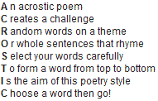
What is an Acrostic Poem? An acrostic poem is a type of poetry where the first, last or other letters in a line spell out a particular word or phrase. The most common and simple form of an acrostic poem is where the first letters of each line spell out the word or phrase.

Slide 5
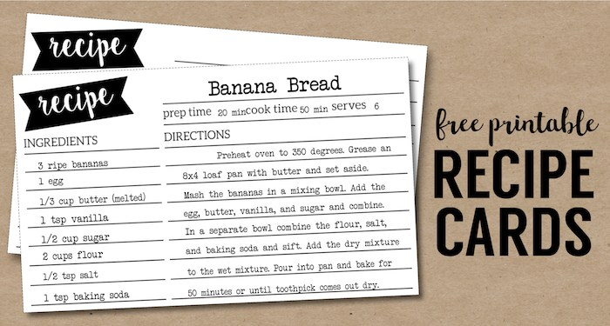
Write a Recipe for a Story
Must include “ingredients” (adjectives and nouns) to describe the character, mood, and the setting.
Must include “directions” on how to put the nouns and adjectives together to create the story.

Slide 6
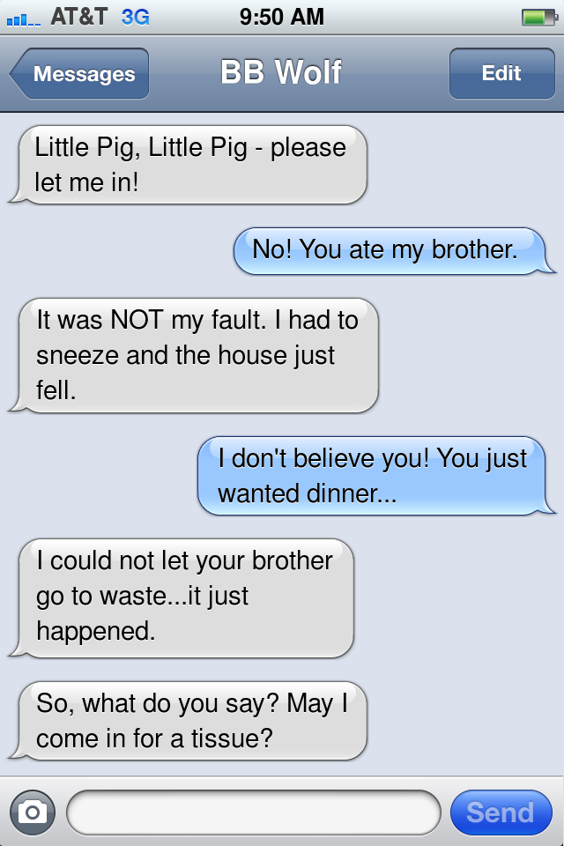
Text Messages
Must follow the events of the story
You are retelling the story from the outside through text messages

Slide 7
Eulogy: a speech or piece of writing that praises someone or something highly, typically someone who has just died.
It must be one full page
You must make inferences to say good things about the old man

Slide 9
Create a Playlist
Two songs for both characters (four total)
One song for the beating heart
One song for the eye
Two songs for the mood
Eight songs total. You will need a summary to how the song connects to the characters, eye, heart, and mood.

Slide 10
Create Movie Poster Your poster should give clues about what will happen in the story

